Slide 1
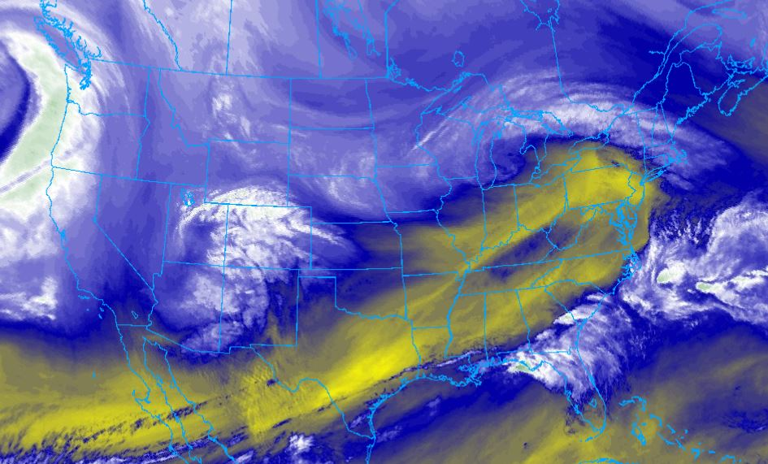
METR 4403/5403
Synoptic Exercise
2/5/2025
Material gathered by Rich Thompson

Slide 2
GOALS
Construct a scientifically reasoned forecast from limited basic data.
2) Develop a reproducible forecast process.

Slide 3
How do we do this?
Using concepts such as:
QG reasoning
PV reasoning
Jet Streak Dynamics
etc...

Slide 4
Keep in mind pt 1...
Right now we’re focusing on the evolution of
synoptic scale features
associated with severe weather events.
Details regarding the thunderstorm environments, mesoscale and storm-scale influences will be covered later.

Slide 5
Keep in mind pt 2...
There are several different forcing mechanisms for ascent/descent in the atmosphere.
Be sure to consider:
Which mechanisms are the strongest?
Where is there overlap of multiple mechanisms?
What influence will these mechanisms have?

Slide 6
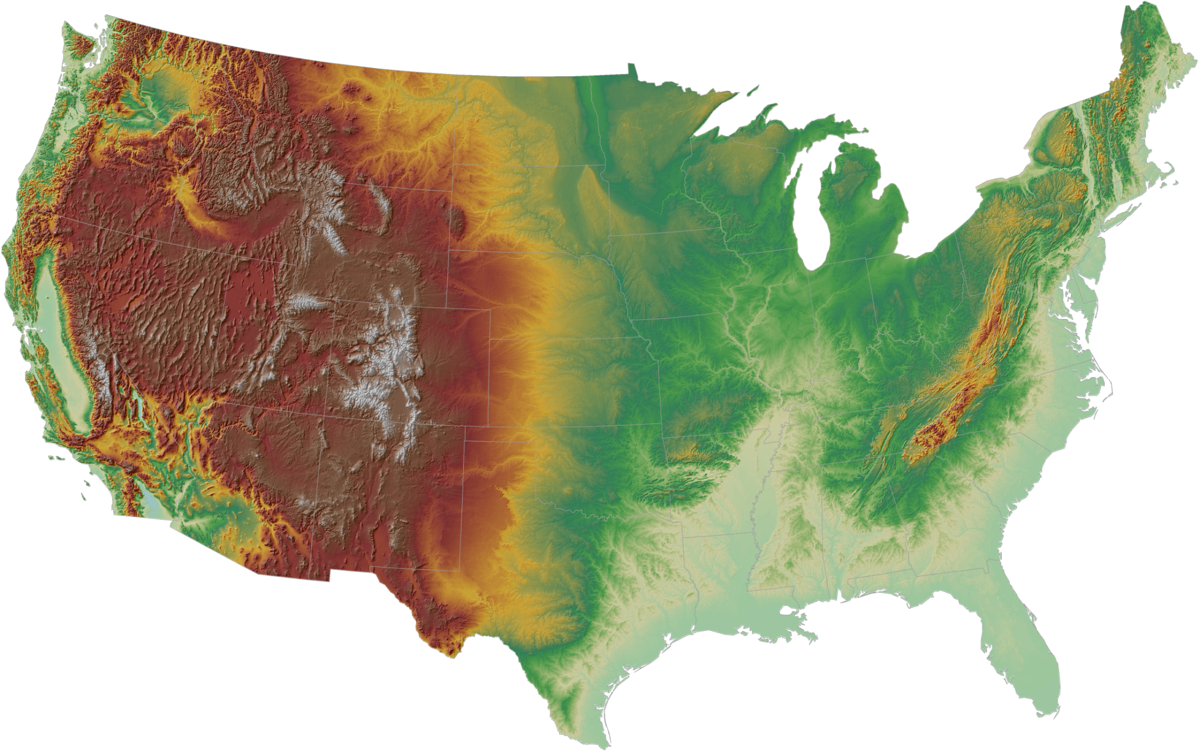
Keep in mind Pt. 3

Slide 7
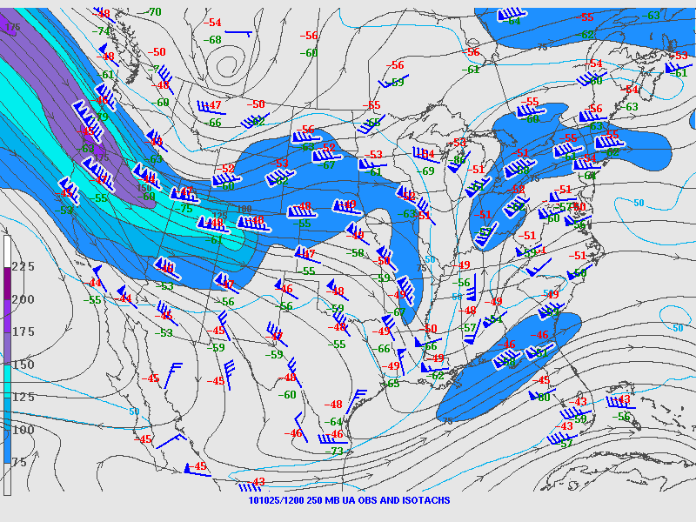
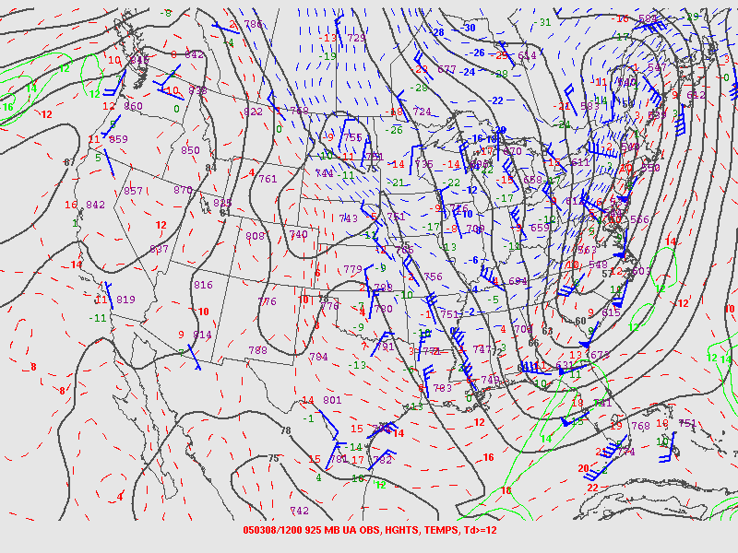
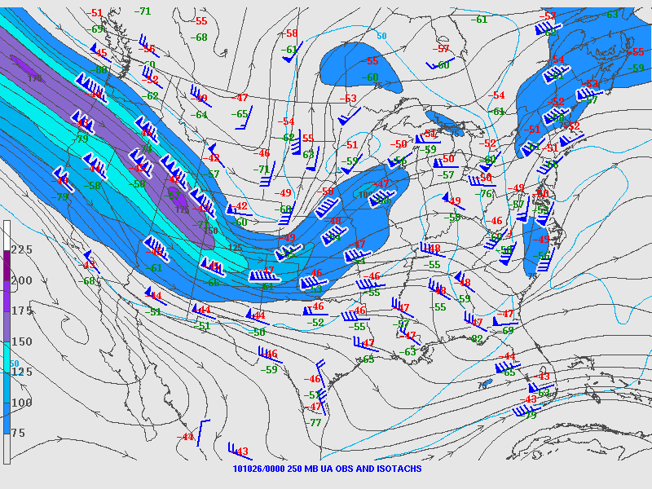
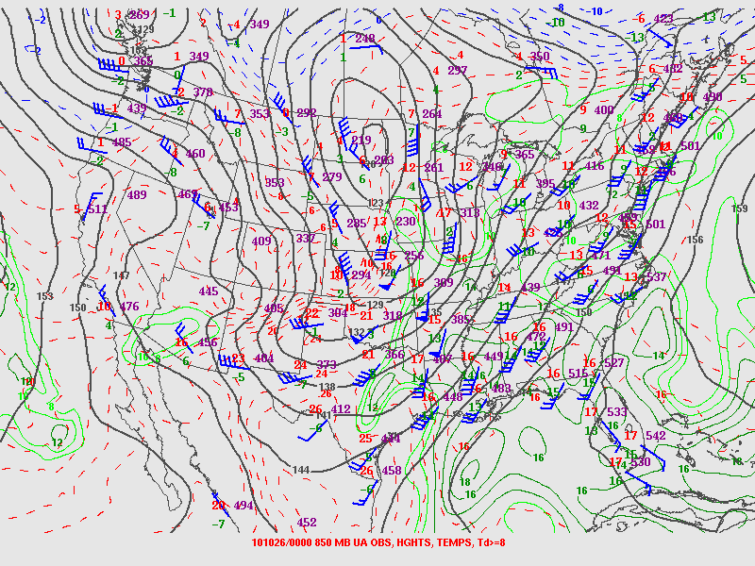
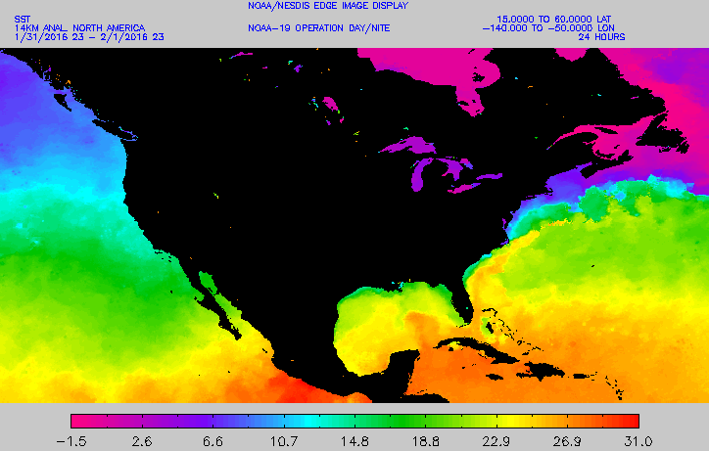
Keep in mind Pt. 4

Slide 8
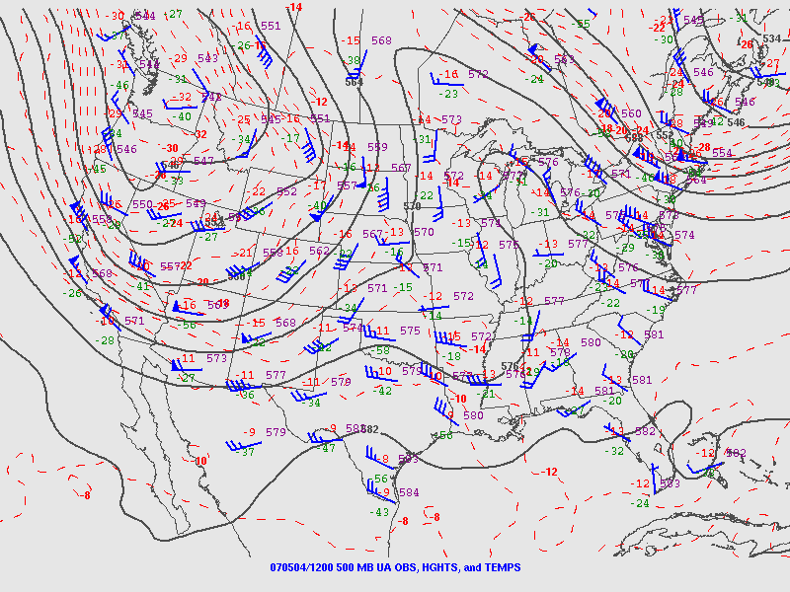

Slide 9
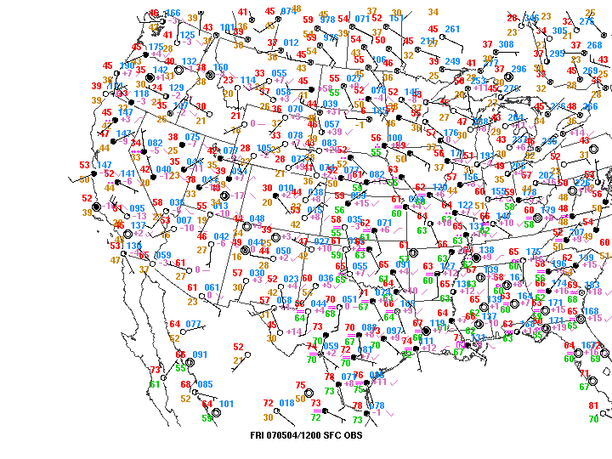

Slide 10
Will there be a strong surface cyclone at 00Z?
If so, where?
Use QG & Lee Cyclogenesis arguments for or against
L

Slide 12
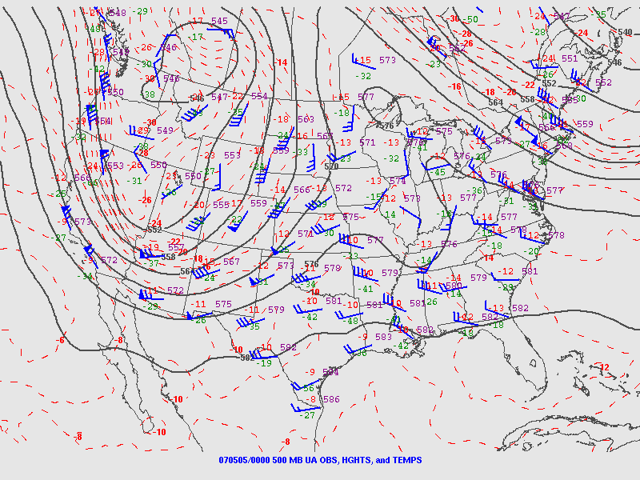

Slide 14
Around 1002 mb

Slide 15
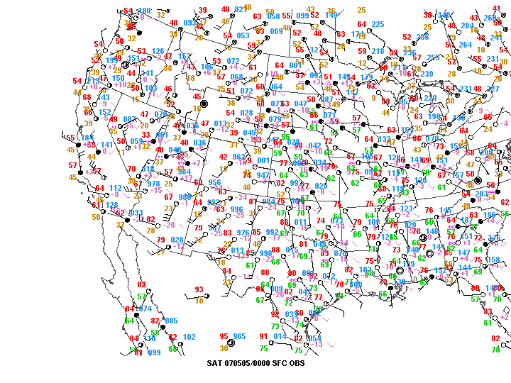
Around 995 mb

Slide 16
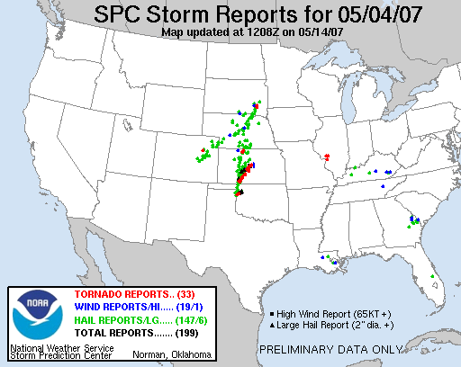
Contributing Factors
Mid-level shortwave trough west/northwest of the Four Corners (stronger QG influences west of the Plains)
Strongest mid-level flow over and across the higher terrain of NM (vs. weaker and more parallel flow along the terrain to the north).
Result = deepening lee cyclone in southeast CO region.

Slide 17
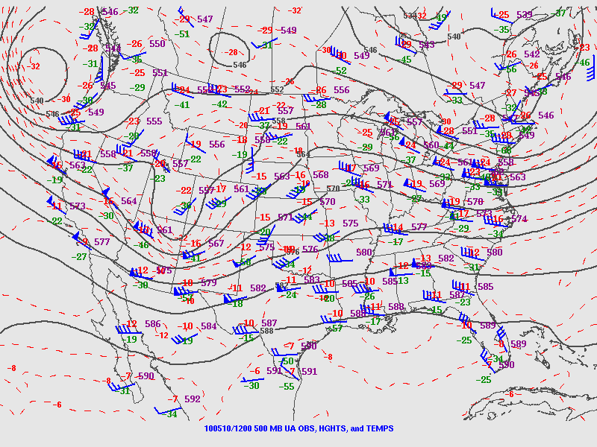

Slide 18
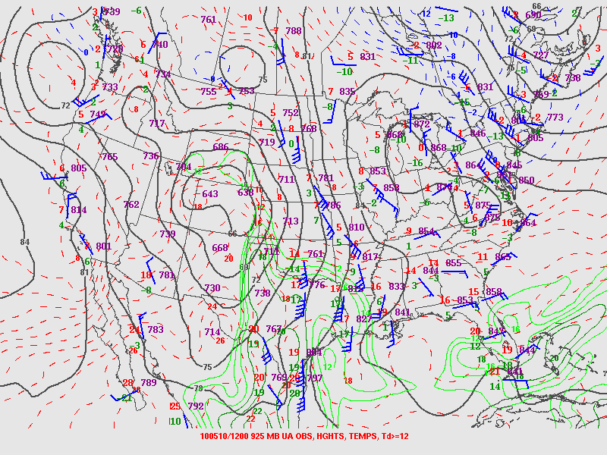

Slide 19
Forecast the 925 mb cyclone at 00 Z
Where will it be located?
Will it deepen?
Use QG arguments to support your answer!

Slide 20
X

Slide 21
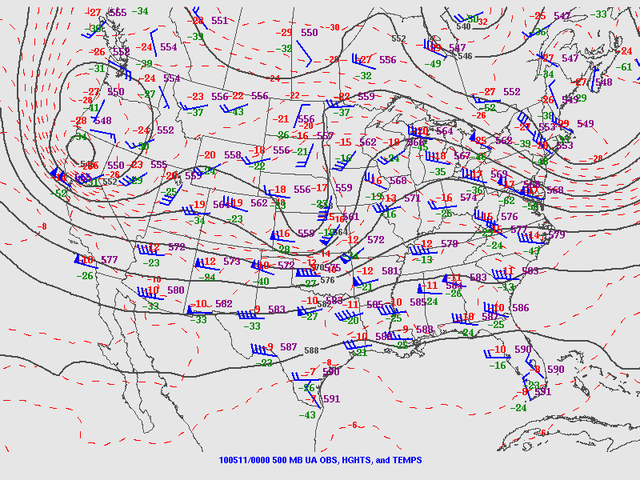
X
X

Slide 22
L

Slide 23
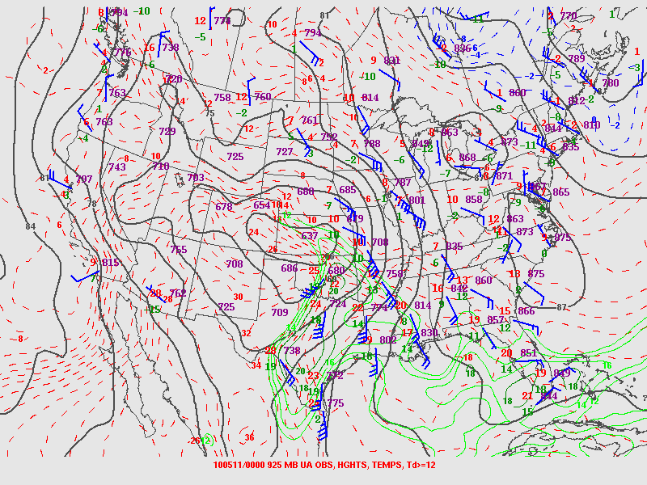
L
L

Slide 24
2b
Contributing Factors
1) Strongest mid-level flow is moving over the
higher terrain in the morning, but is exiting by
the afternoon.
2) Lee cyclogenesis/troughing continues (due to persistent zonal flow over the S. Rockies), but becomes secondary to:
2a) Low-level warm advection over OK
2b) Inferred DCVA over KS/OK
Net result = non-deepening low that shifts east/southeast.
2
1
2a

Slide 25
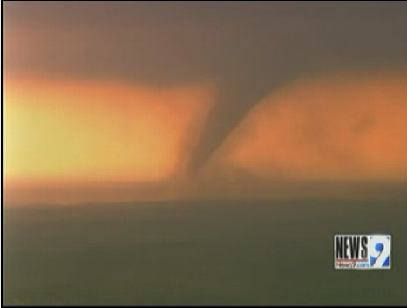
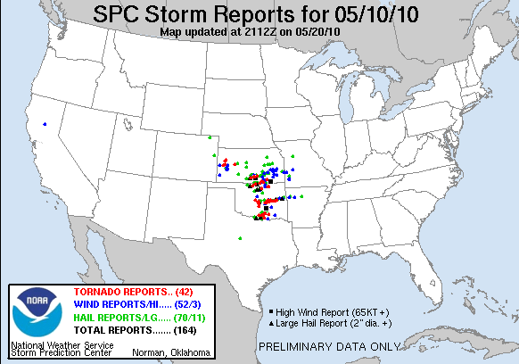
Contributing Factors
1) Strongest mid-level flow is moving over the
higher terrain in the morning, but is exiting by
the afternoon.
2) Lee cyclogenesis/troughing continues (due to persistent zonal flow over the S. Rockies), but becomes secondary to:
2a) Low-level warm advection over OK
2b) Inferred DCVA over KS/OK
Net result = non-deepening low that shifts east/southeast.

Slide 28
Forecast the 850 mb cyclone at 12 Z
Where will it be located?
Will it deepen?
Use QG arguments to support your answer!

Slide 30
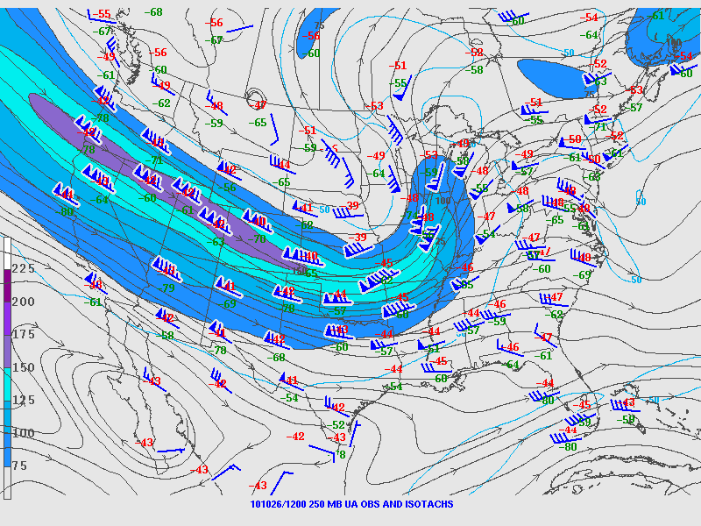

Slide 32
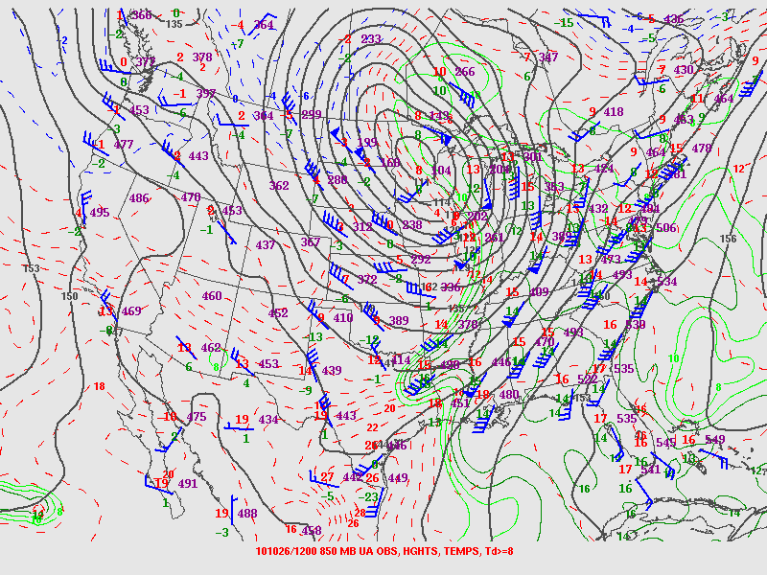

Slide 33
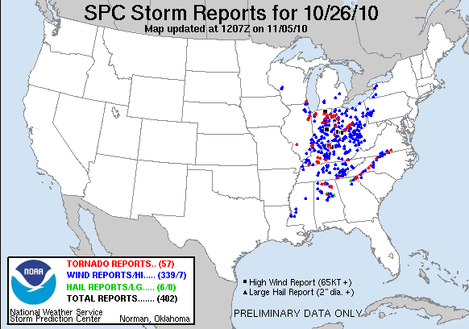
Contributing Factors
Began with large cyclone in the lee of the northern Rockies.
Intense jet streak aloft moves into the northern Plains.
Lift from left exit region.
Inferred lift via DCVA
Result = deepening low over Dakotas/West MN.

Slide 34
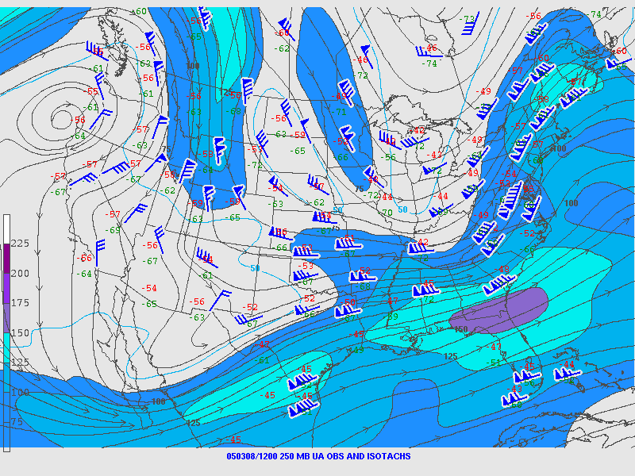

Slide 35
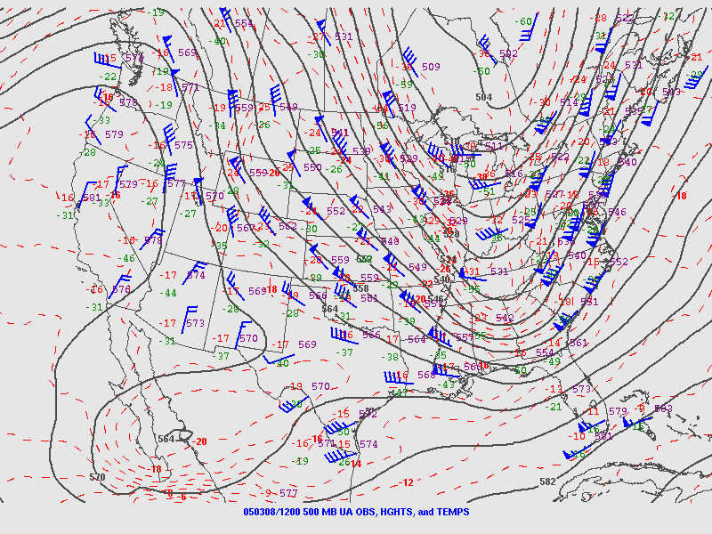

Slide 37
Forecast the 925 mb cyclone at 00 Z
Where will it be located?
Will it deepen?
Use QG arguments to support your answer!

Slide 42
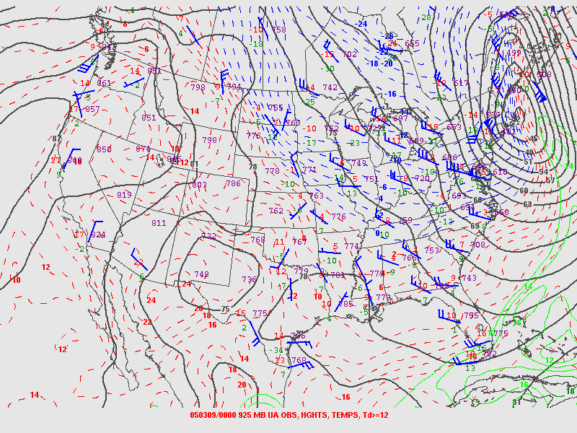

Slide 43
Contributing Factors
Coupled upper-level jet structure.
Inferred lift from DCVA ahead of the approaching shortwave trough.
Strong low-level warm air advection across Maine.
Warm ocean waters from the Gulf Stream allow for reduced low-level static stability/steepening low-level lapse rates, which allow for easier/efficient deepening of the low.

Slide 44
Deducing Surface Flow Patterns
We’ll see the progression of the pattern over several days.
Given a single 500 mb chart, try to anticipate:
1) The expected surface pressure pattern
2) The resulting low-level moisture return pattern from the Gulf of Mexico into the southern Plains

Slide 45
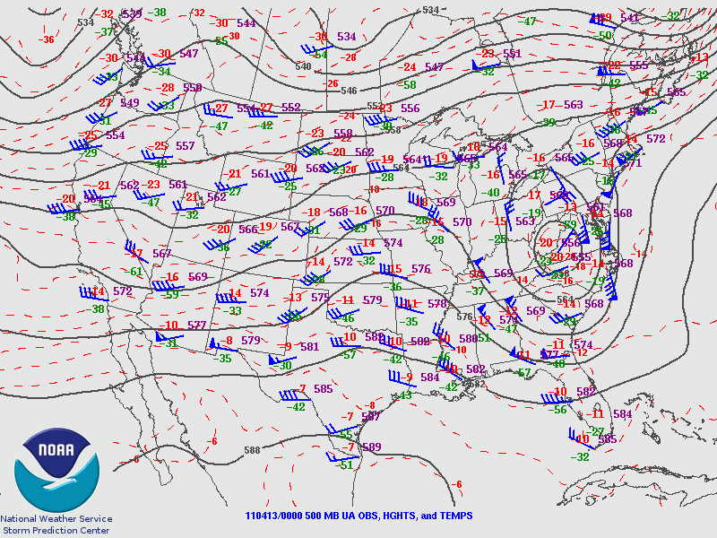

Slide 46
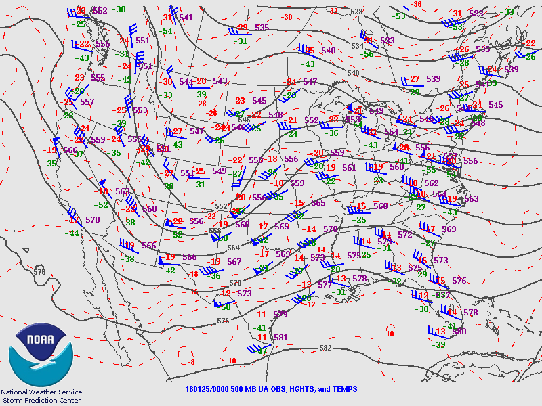
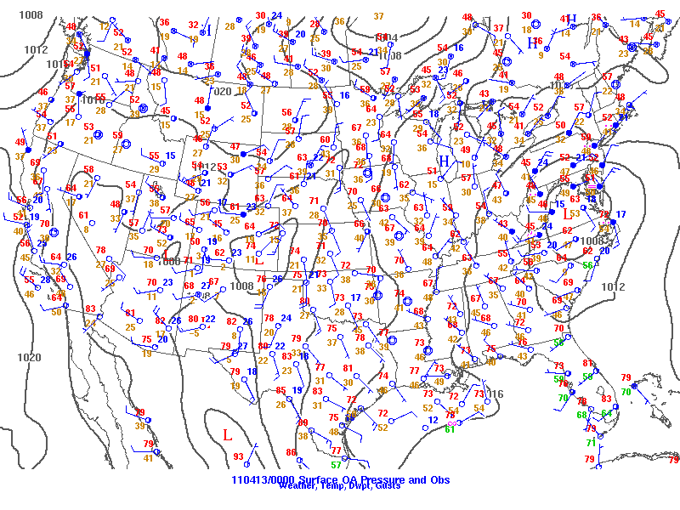

Slide 47
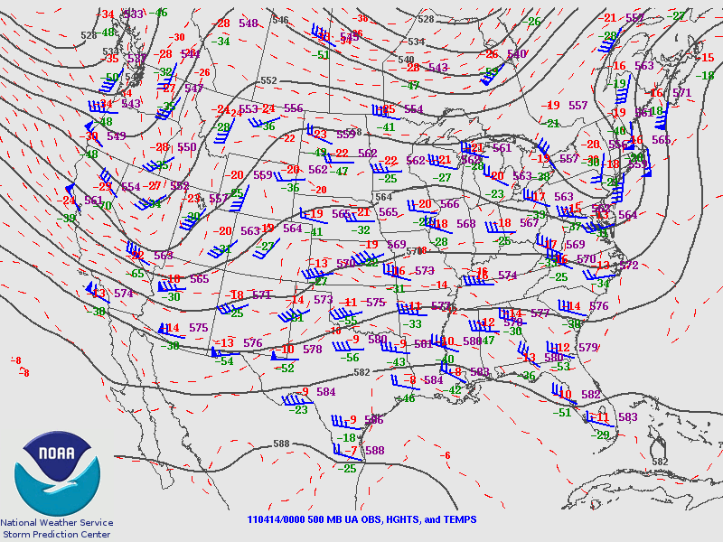

Slide 48
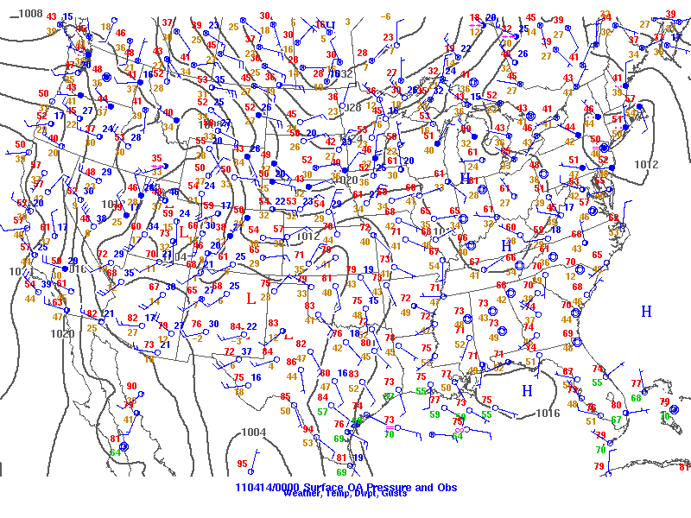

Slide 49
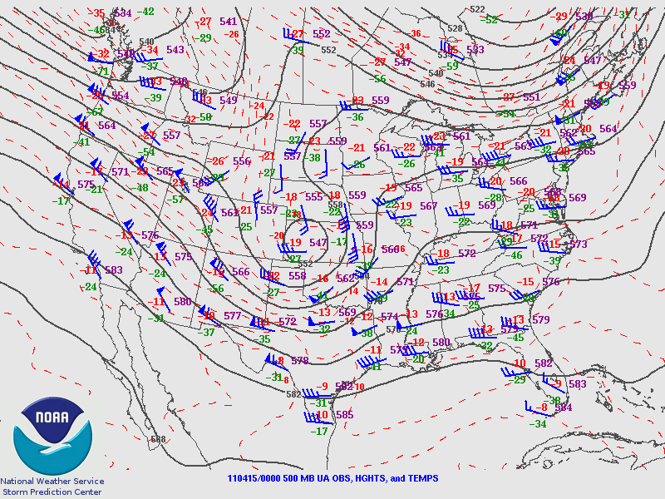

Slide 50
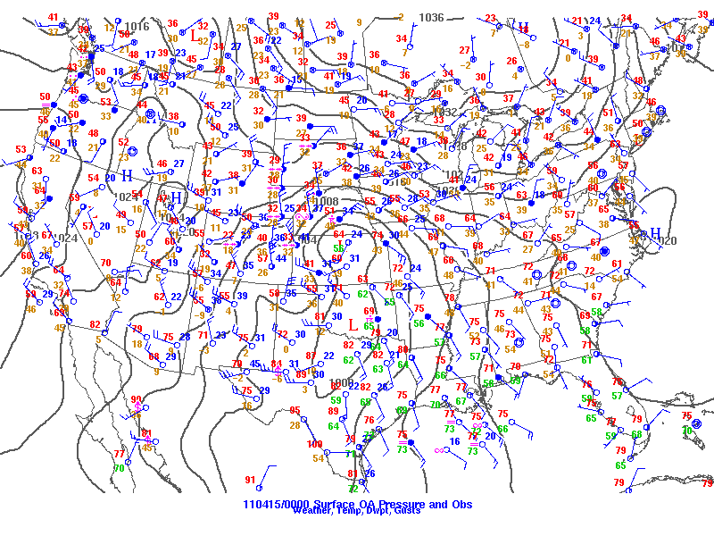

Slide 51
Deducing Lapse Rates
Given:
12 Z and 00 Z 700 mb charts
Predict:
Which location will see the
steepest 700-500 mb lapse rates?

Slide 52
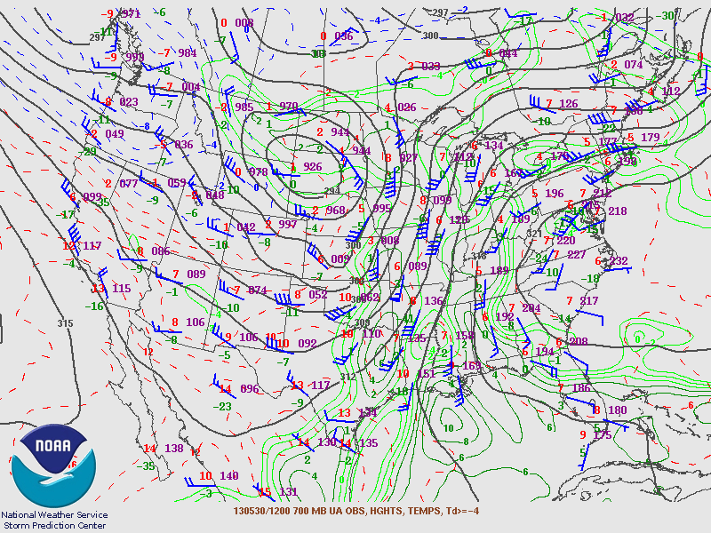

Slide 53
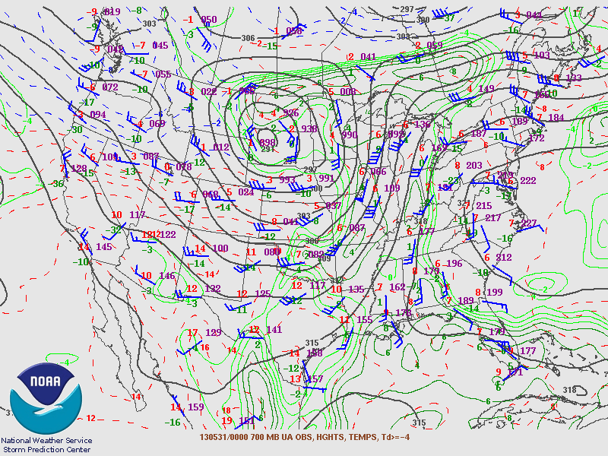

Slide 54
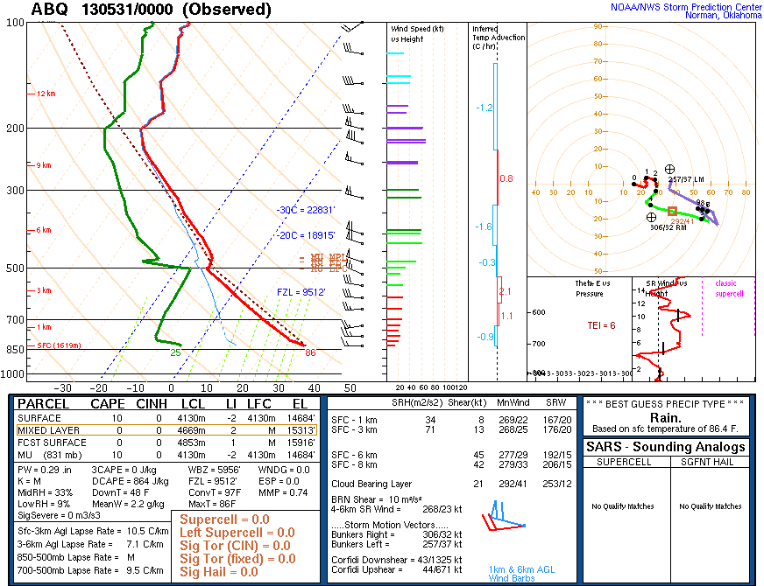

Slide 55
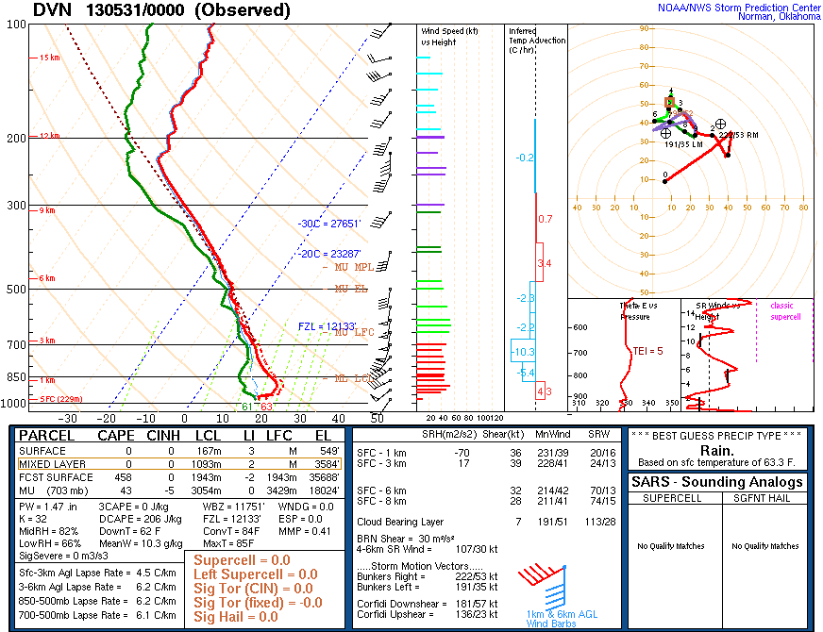

Slide 56
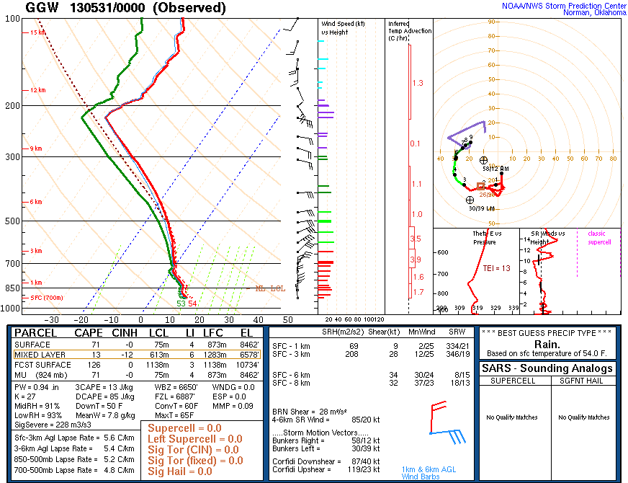

Slide 57
Deducing Lapse Rates
Given:
00Z 700 mb and 500 mb charts
Predict:
Which location will see the
steepest 700-500 mb lapse rates?

Slide 58
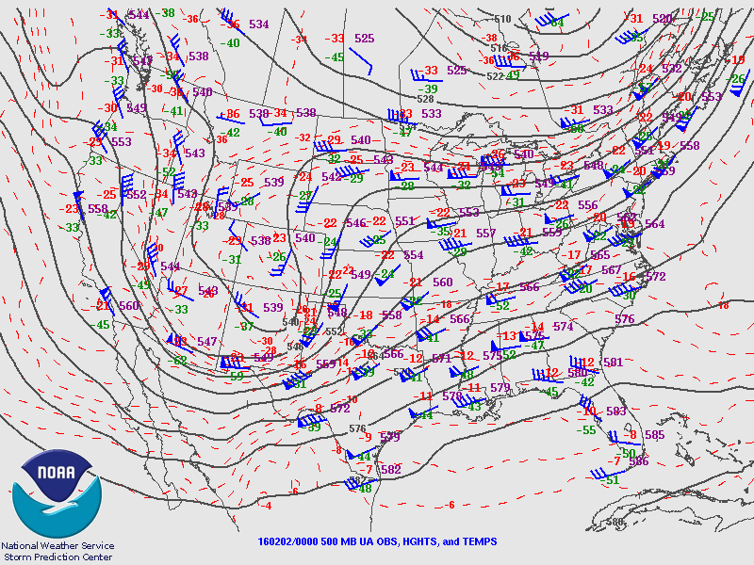

Slide 59
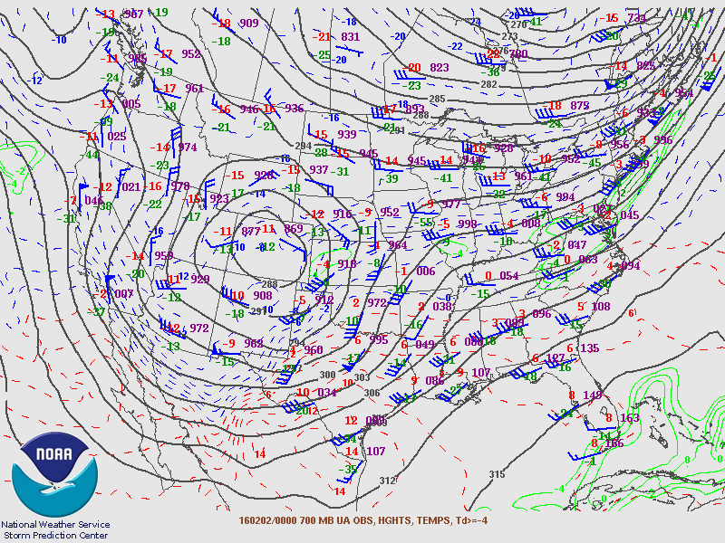

Slide 60
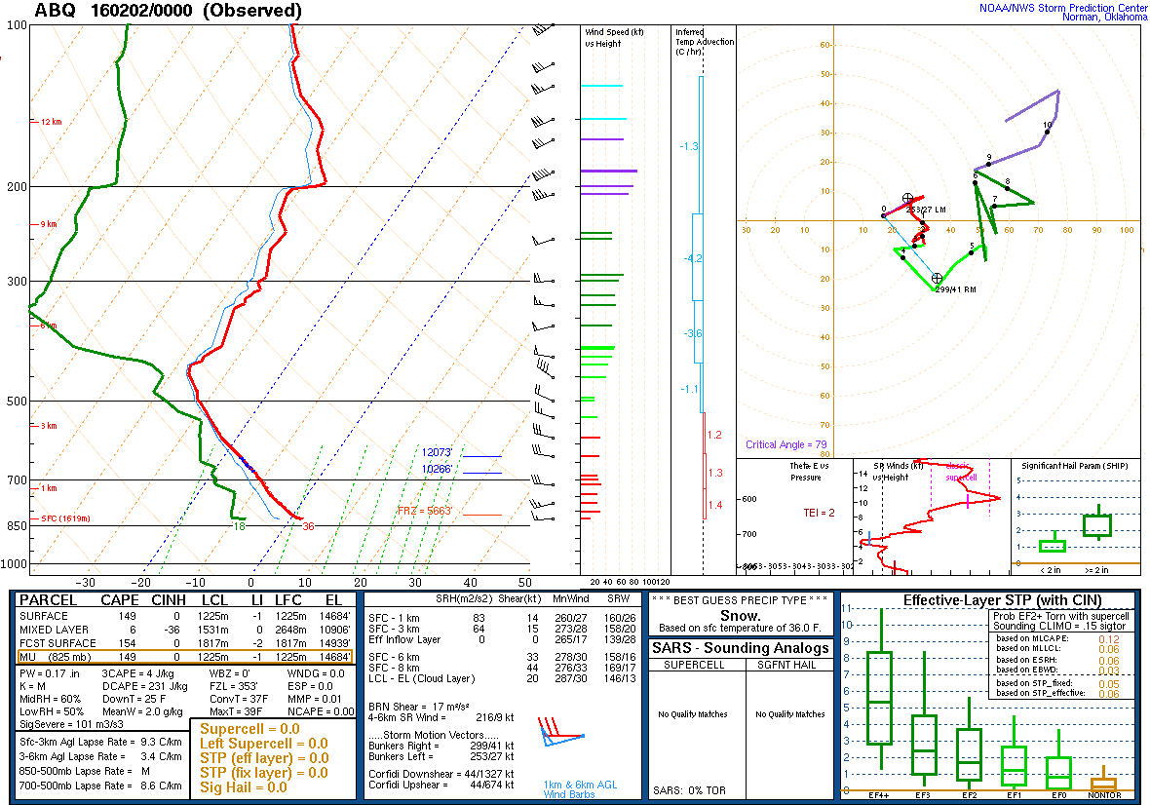

Slide 61
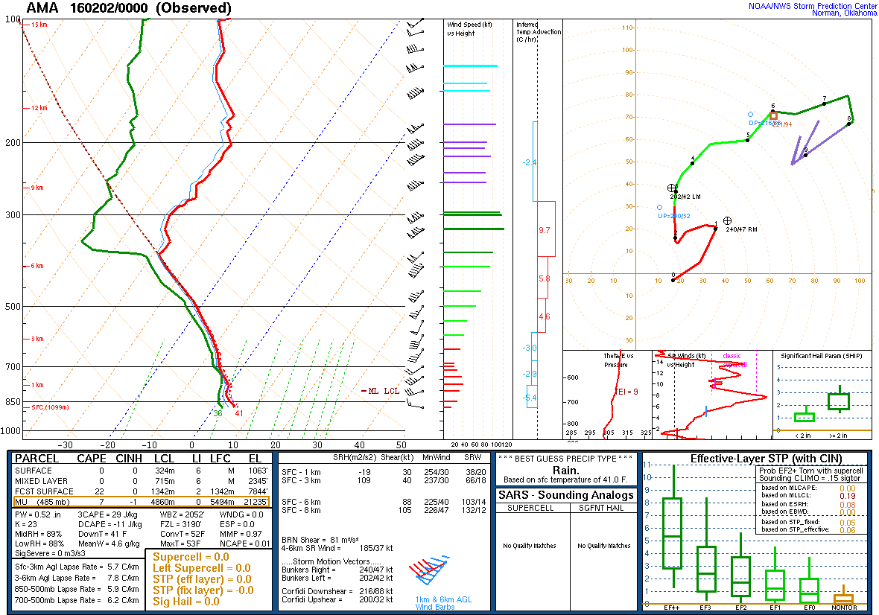

Slide 62
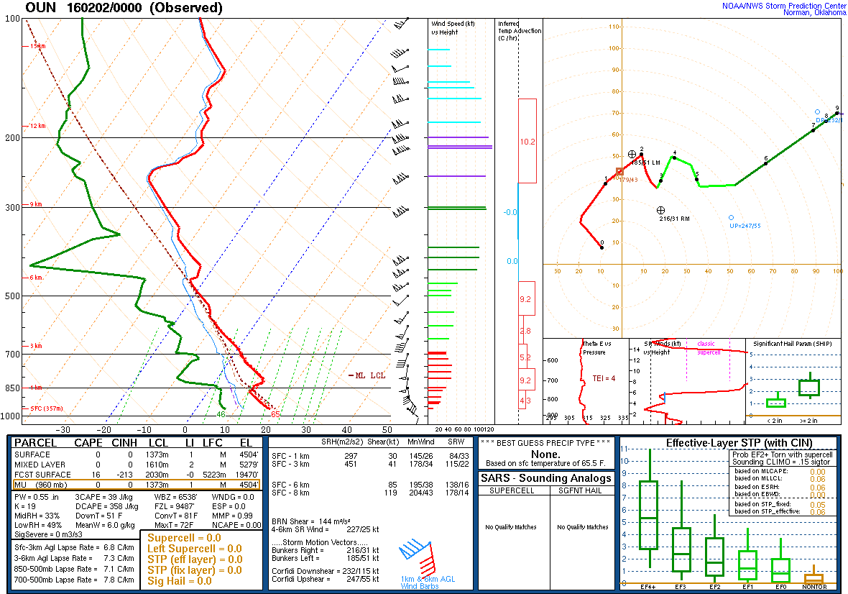

Slide 63
Congrats, you’re done!
Key Takeaways:
Even with limited data, you can use synoptic concepts to create a forecast.
These analytical skills aid in interpreting model output.
Always think about what you can observe and infer before jumping to conclusions!
Finally: Practice! Practice! Practice!

